Slide 1

Using Nextstrain and Nextclade to Analyse Dengue Sequences
Ammar Aziz – VIDRL

Slide 2
Objectives
Refresher on Phylogenies
Dengue global surveillance using Nextstrain
Clade/Lineage analysis using Nextclade

Slide 3
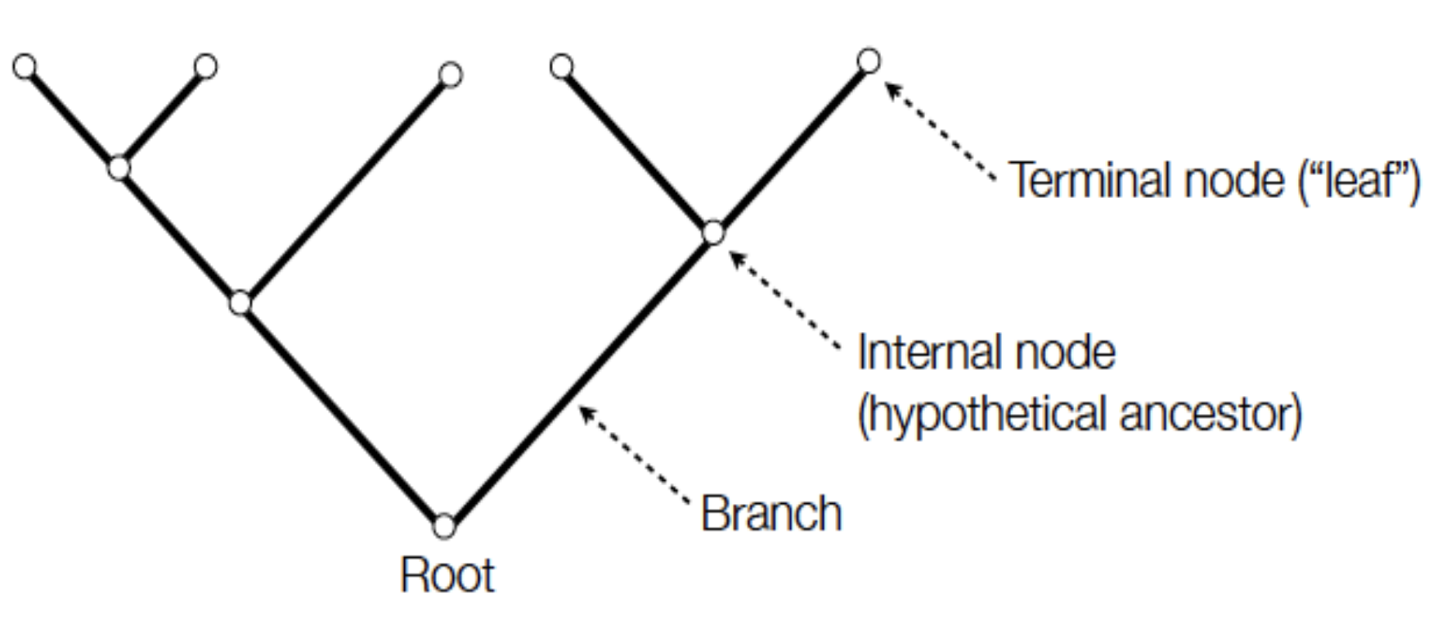
Trees - Terminology

Slide 4
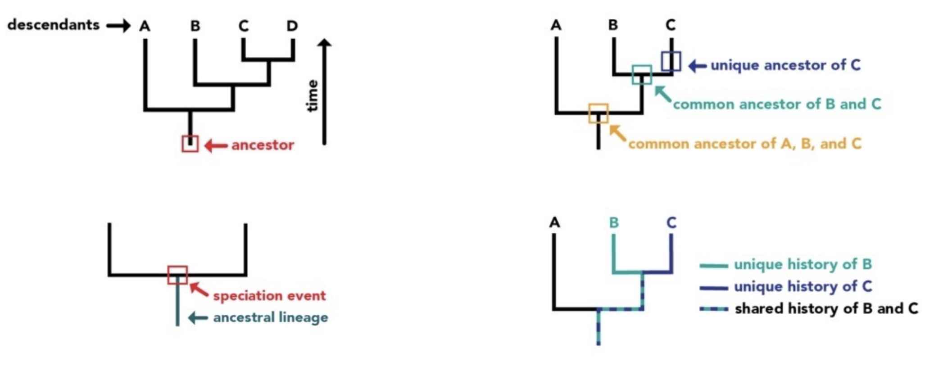
Reading Trees

Slide 5
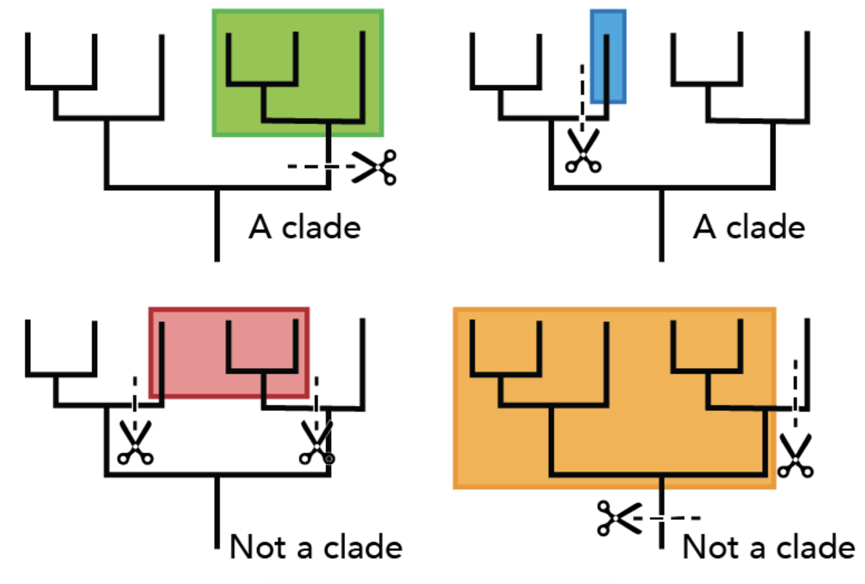
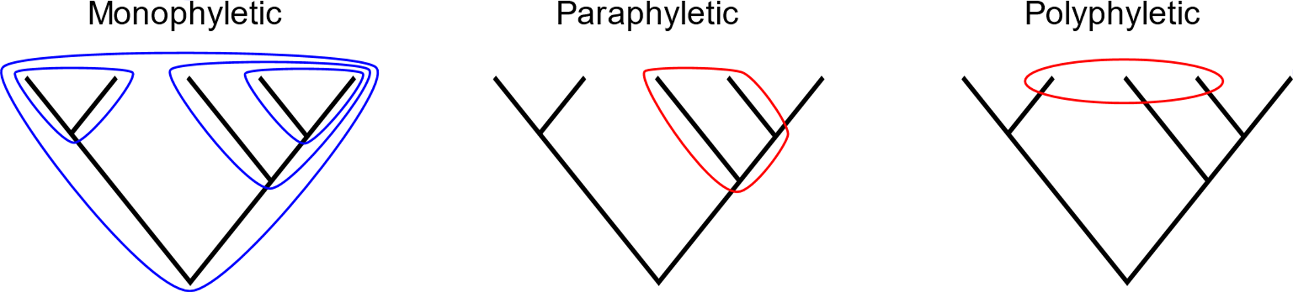
What is a Clade?
Monophyletic group - All and only the descendants of a common ancestor (including that ancestor).
Paraphyletic group - Does not include all of the descendants of the common ancestor.
Polyphyletic group - Does not include the common ancestor.

Slide 6
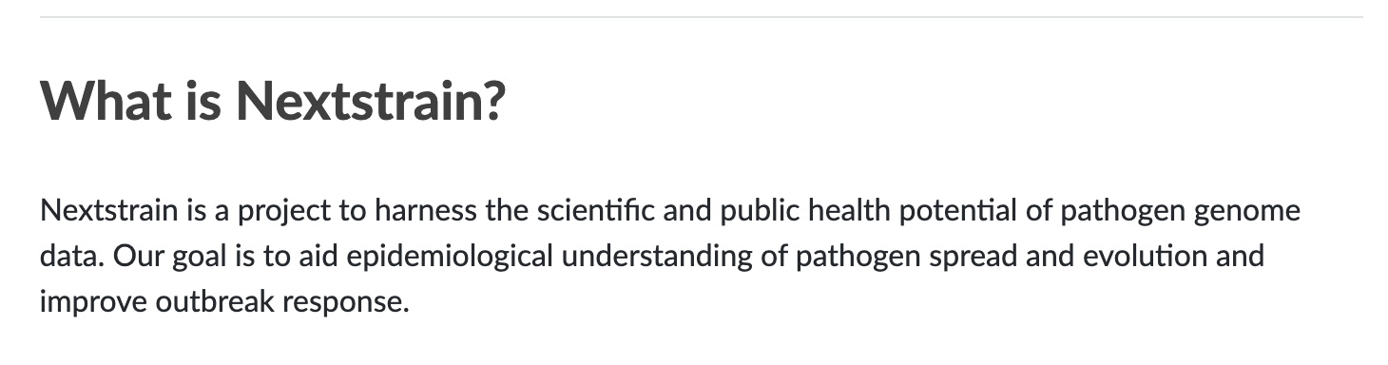

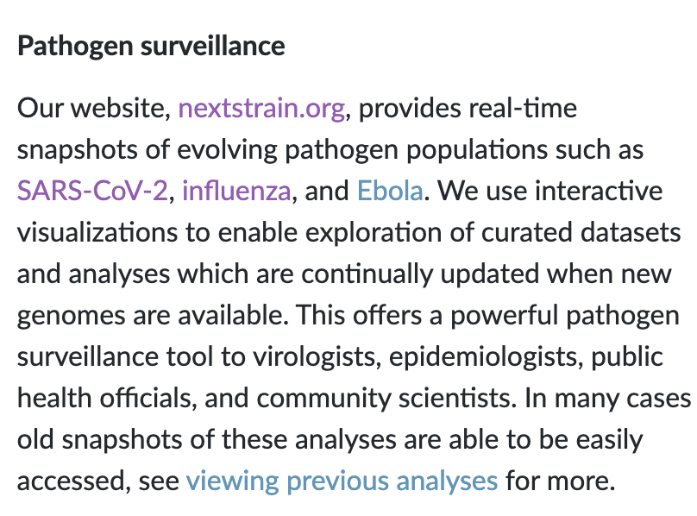
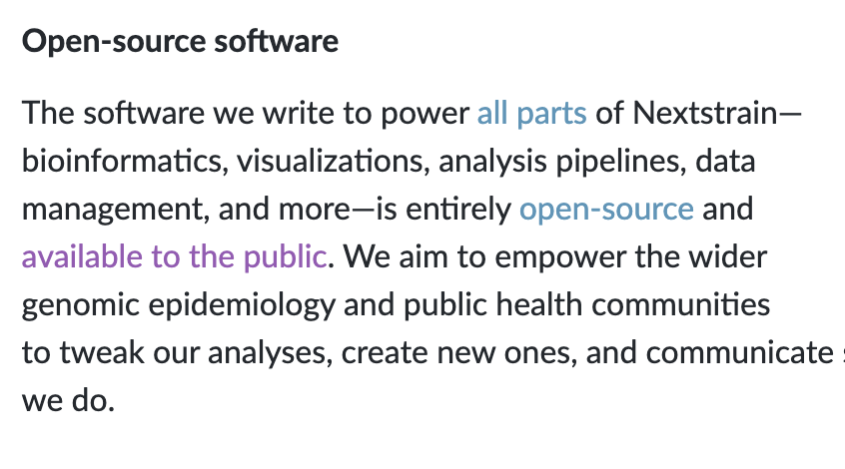

Slide 7
Nextstrain – Reading trees
https://nextstrain.org/narratives/trees-background/

Slide 8
Nexstrain Demostration
Dengue E tree: https://nextstrain.org/dengue/all/E
Filtering:
By country
By serotype
Change colors:
Date
Country
Region
Interactively explore tree
Tanglegram (WGS – E tree)

Slide 9
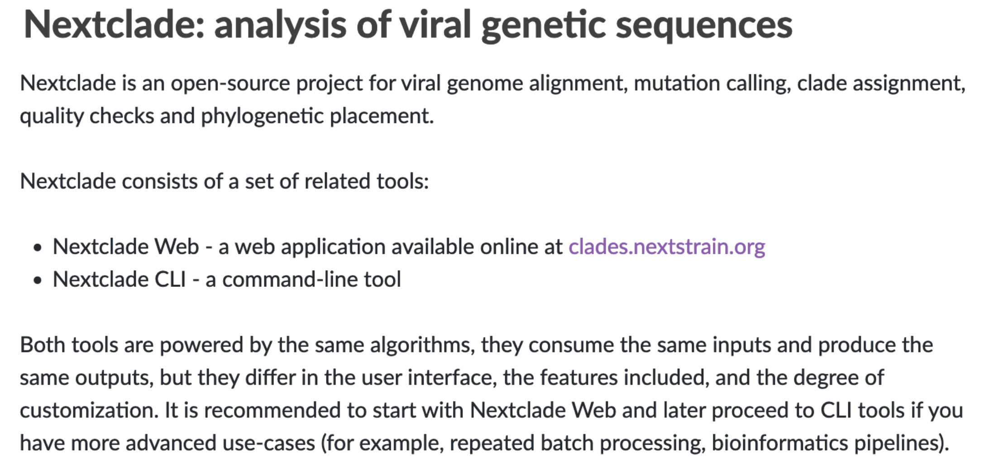

Slide 10
Download sequencing data
Go to XXXXXX
Download your data and a country specific dataset
Launch Nextclade.org

Slide 11
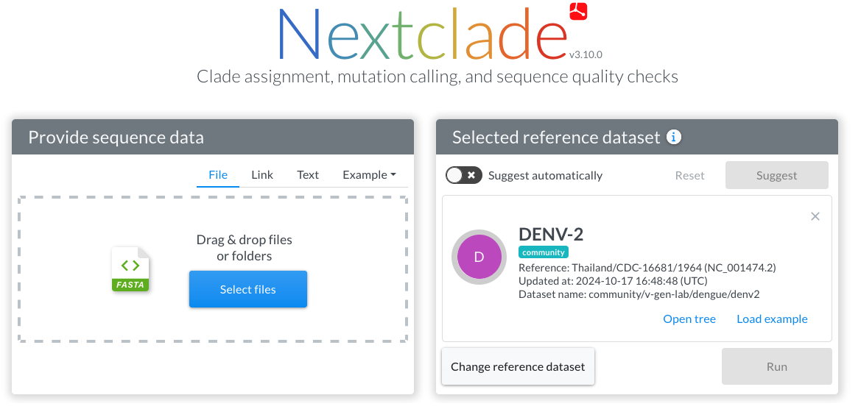
Data input here
Select reference dataset here

Slide 12
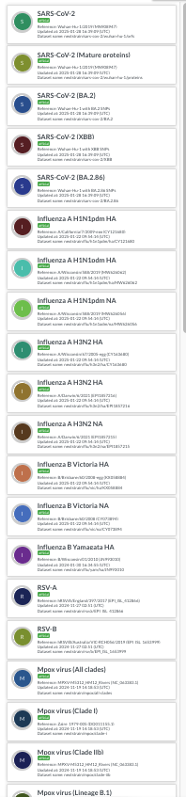

Nextclade supports many viruses

Slide 13
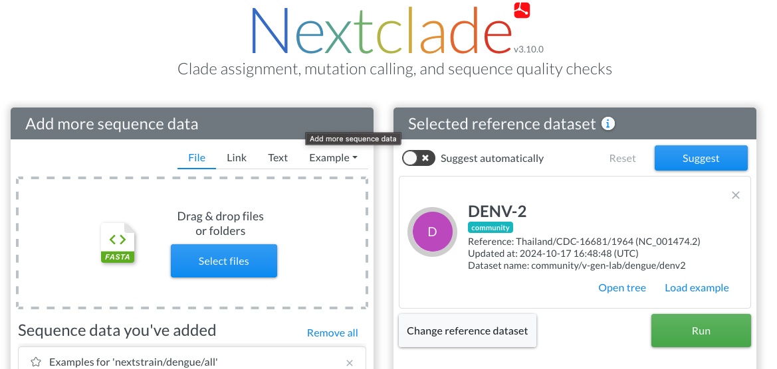
If unsure which ref dataset, click 'Suggest'
Click Run to start analysis

Slide 14
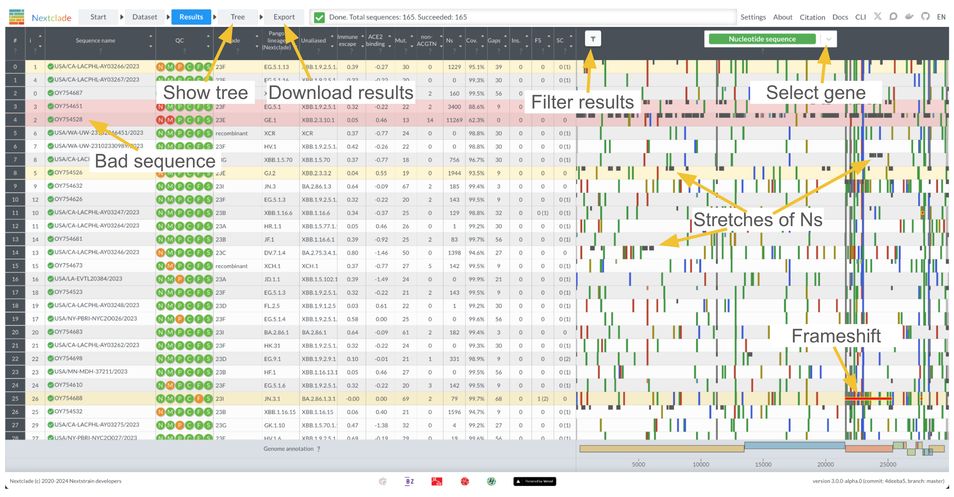

Slide 15
“Mut.”: number of mutations with respect to the reference sequence
“non-ACGTN”: number of ambiguous nucleotides that are not N
“Ns”: number of missing nucleotides indicated by N
“Gaps”: number of nucleotides that are deleted with respect to the reference sequence
“Ins.”: number of nucleotides that are inserted with respect to the reference sequence
“FS”: Number of uncommon frame shifts (total number, including common frame shifts are in parentheses)
“SC”: Number of uncommon premature stop codons (total number, including common premature stops are in parentheses)

Slide 16
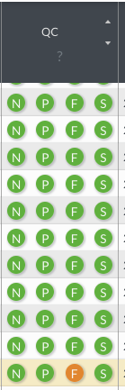
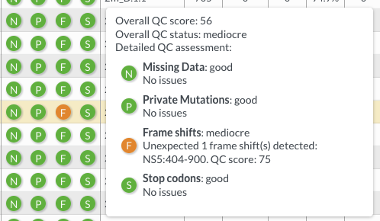
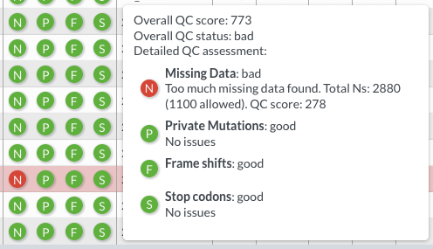
QC Field
Hover mouse over highlighted sample to show popup.
Warning
Failed
Why was it marked as fail? Too much missing data (N or -)

Slide 17




QC Metrics
Missing Data – threshold 1000
Private Mutations – cutoff 216, typical 72
Frame Shift
Stop Codon
Nextclade implements a variety of quality control metrics to quickly spot problems in your sequencing/assembly pipeline.
Bad sequences are colored red, mediocre ones yellow and good ones white. You can view detailed results of the QC metrics by hovering your mouse over a sequences QC entry:

Slide 18
Change Genetic Feature to Nucleotide to show full genome
Note: In Dengue the E gene is routinely sequenced as it's genetically distinct between serotypes and provides sufficient resolution for clade information and possible lineage information.

Slide 19
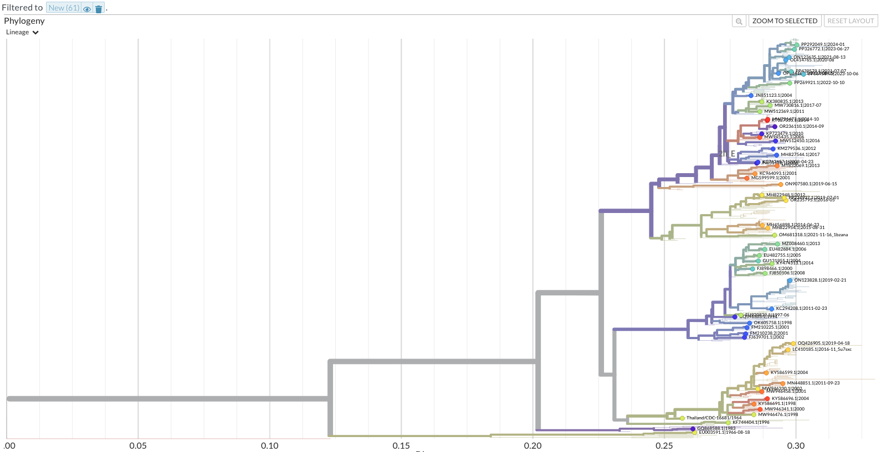
Click on the "Tree" button to see where your sequences have been placed.
The tree is nearly identical to Nextstrain tree, so interact with it.

Slide 20
Nextclade Demonstration
Loading consensus sequences
Selecting datasets
Interpreting results
Exporting results

Slide 21
Nextclade Practice
Use the amplicon data you generate in the lab to answer these questions:
What is the clade/lineage of each sample?
Check each samples QC metrics, which would you use for:
Clade/Lineage calling?
Phylogenetic analysis?
Speciation?
Check for odd genomic features (premature stop, gaps, etc).
Which samples would you pass/fail?

Slide 22
Questions? + Resources
Nextclade is also a CLI tool and is avaliable in Galaxy.
https://docs.nextstrain.org/projects/nextclade/en/stable/user/nextclade-cli/index.html
The web interface is excellent, provides all the features of the CLI and even more.
It's possible to create your own reference datasets for Nextclade but it requires knowledge of the organism and advanced bioinformatic skills.

